Slide 1

Parametric Speech Coding
Ahmet Erdem Çağatay – Şafak Tüfekçi
ELEC 404

Slide 2
Phase 1

Slide 3

Theory
The human sound production mechanisms can be modelled as excitation generator located at the throat, creating impulse train or white noise according to the sound to be produced, where impulse train is representing the vowels and the white noise is representing the consonants.
These sounds are then ‘shaped’ throughout the folds of the vocal tract, namely lips, tongue, palate, pharynx etc. in accordance with the sound aimed to be produced in the context of the speech.
The vocal tract itself can be approximated as an open ended tube with varying thickness and length, shaping itself throughout the speech in order to generate unique harmonics of each phoneme, by suppressing or amplifying various bands or regions of the frequency spectra of the excitation signal, resulting with proper speech sounds. These mentioned harmonics are called as formants, and each phoneme has its own unique formant, meaning that each phoneme has a characteristic distribution of its frequency spectra.

Slide 4
Theory
This suppressing and amplifying behavior of the vocal tract can be modelled by an all-pole linear finite impulse response filter. For our project, we were given the task of approximating the vocal track as a time varying 10-pole FIR filter.
Our motivation for these models is to extract the related coefficients of the 10-pole FIR filter from the speech signal by a technique called Linear Predictive Coding, to deconstruct the speech signal into the excitation signal as it is generated at the throat by applying the inverse filter. In order to achieve that, first we need to find the parameters of the said filter.

Slide 5
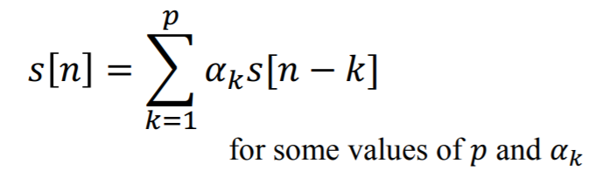
The basic assumption of Linear Predictive Coding
From our knowledge of speech production mechanisms obtained throughout the course, we know that each instance of speech is related to the next or the previous instances of the same speech. By mustering the said fact, Linear Predictive Coding predicts the next instance of the speech by a weighted combination of the previous instances, capturing the characteristics of the vocal tract at the moment of the speech production.

Slide 6

Implementation

Slide 7

Encoder
Framing the speech signal into two milliseconds frames, which corresponds to a 160-sample frame for 8 kHz sampling rate, with 50% frame shift.
Each frame is windowed by Hanning window of equal size.
Calculating a 10 step autocorrelation, and retaining the values to obtain an autocorrelation vector, where autocorrelation vector is generated without any use of built-in MATLAB functions.
Calculated reflection coefficients from autocorrelation vector by Levinson-Durbin algorithm. Then, calculated filter coefficients/parameters from reflection coefficient.
Extracted excitation signal by applying the filter to the speech signal. Returning the user PARCOR coefficients, excitation signal and gain of the filter.

Slide 8
Decoder
Takes excitation signal, PARCOR coefficients as input. Constructs a filter by using PARCOR coefficients, which is the inverse filter that was implemented in the encoder.
Applies the recently constructed filter to the excitation signal.
Returns reconstructed signal, which is supposed to be the same as speech signal that we used at the encoder, without any loss.

Slide 9
Phase 2

Slide 10
Theory
The idea behind the vector quantization is to group sets of data in a way that each subgroup is consisted of similar data points, or namely clusters. The number of the subgroups are chosen as necessary, depending on the application.
In our project, we used k-means clustering algorithm, which iteratively ‘trains’ to locate points called centroids.
By using the codebook generated prior to the application, the de-quantization or decoding process happens by referring to the codebook for the assigned outcome of each combination of bits allocated.

Slide 11
Implementation

Slide 12

Quantization
For PARCOR Parameters, we used 1-D clustering. K-means clustering method is used to divide the data to their respective groups, with the help of built-in MATLAB function kmeans().
For excitation signal, we were assigned to use 480 bits or 240 bits for each segment of the excitation signal, depending on the codec.
We reduced sample size to 80 data point, to have 3 or 6 bits for representation, meaning that 8 or 64 point clustering will be implemented in our design.

Slide 13
Encoder & Decoder
During the implementation of Phase 2, the encoder and decoder parts of the code were kept intact, and the only difference being the quantization.

Slide 14
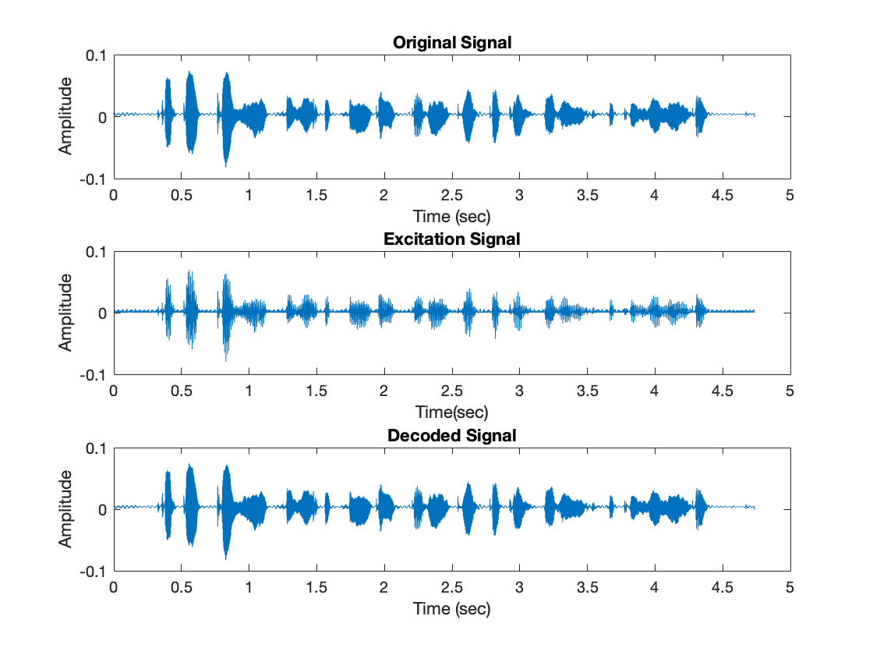
A visual comparison of Original, Excitation and Decoded signal, without quantization

Slide 15
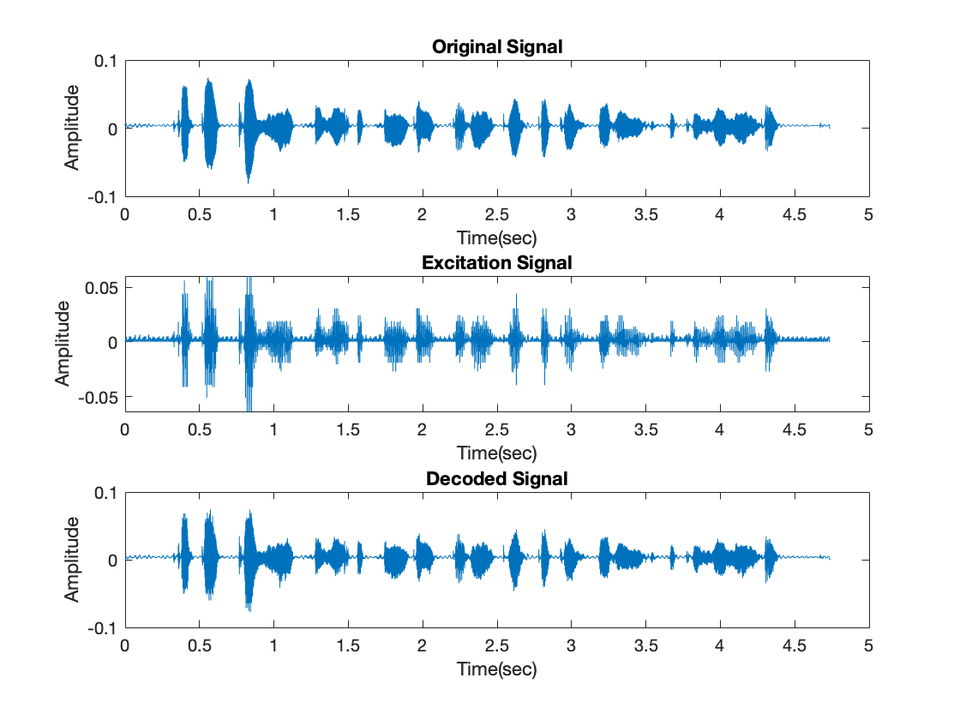
A visual comparison of Original, Excitation and Decoded signal, with quantization

Slide 16

Thanks for listening!

